Slide 1
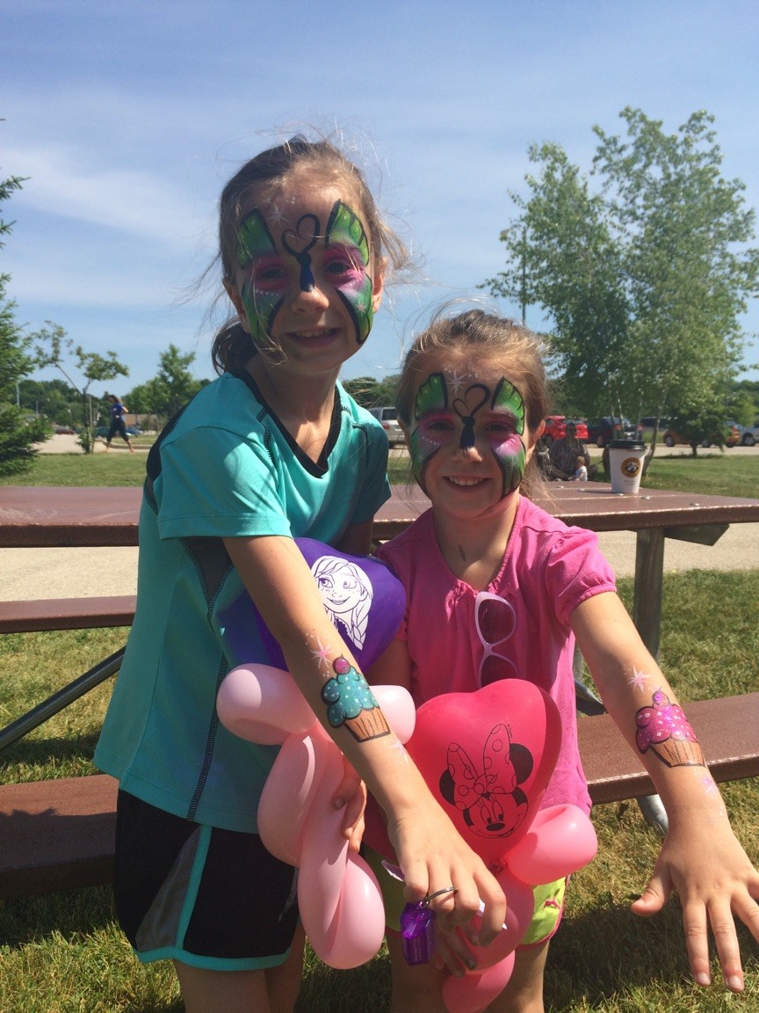
2-mile walk 5K & 10K run
live music & family fun
Saturday, June 3, 2017
Wisconsin Lutheran College Athletic Complex
Learn more and register at www.homeformothers.com

